Slide 1

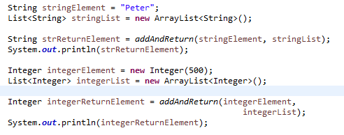
Java Generic Methods
It is possible to generify methods in Java. Here is an example:
This method specifies a type T which is used both as type for the element parameter and the generic type of the Collection.
How does the compiler know the type of T?
The answer is, that the compiler infers this from your use of the method.
Notice how we can call the addAndReturn() method using both String's and Integer's and their corresponding collections. The compiler knows from the type of the T parameter and collection<T>parameter definitions, that the type is to be taken from these parameters at call time (use time).

